Slide 1

Death and Suicide in the United States
Nikhil Vytla, Jackson McKenzie, Lucas Chen

Slide 2

Data Visualization
Notes:
Alt-Tab to Tableau
Alt-Tab to Excel Pivot Tables

Slide 3

General Insights

Slide 4
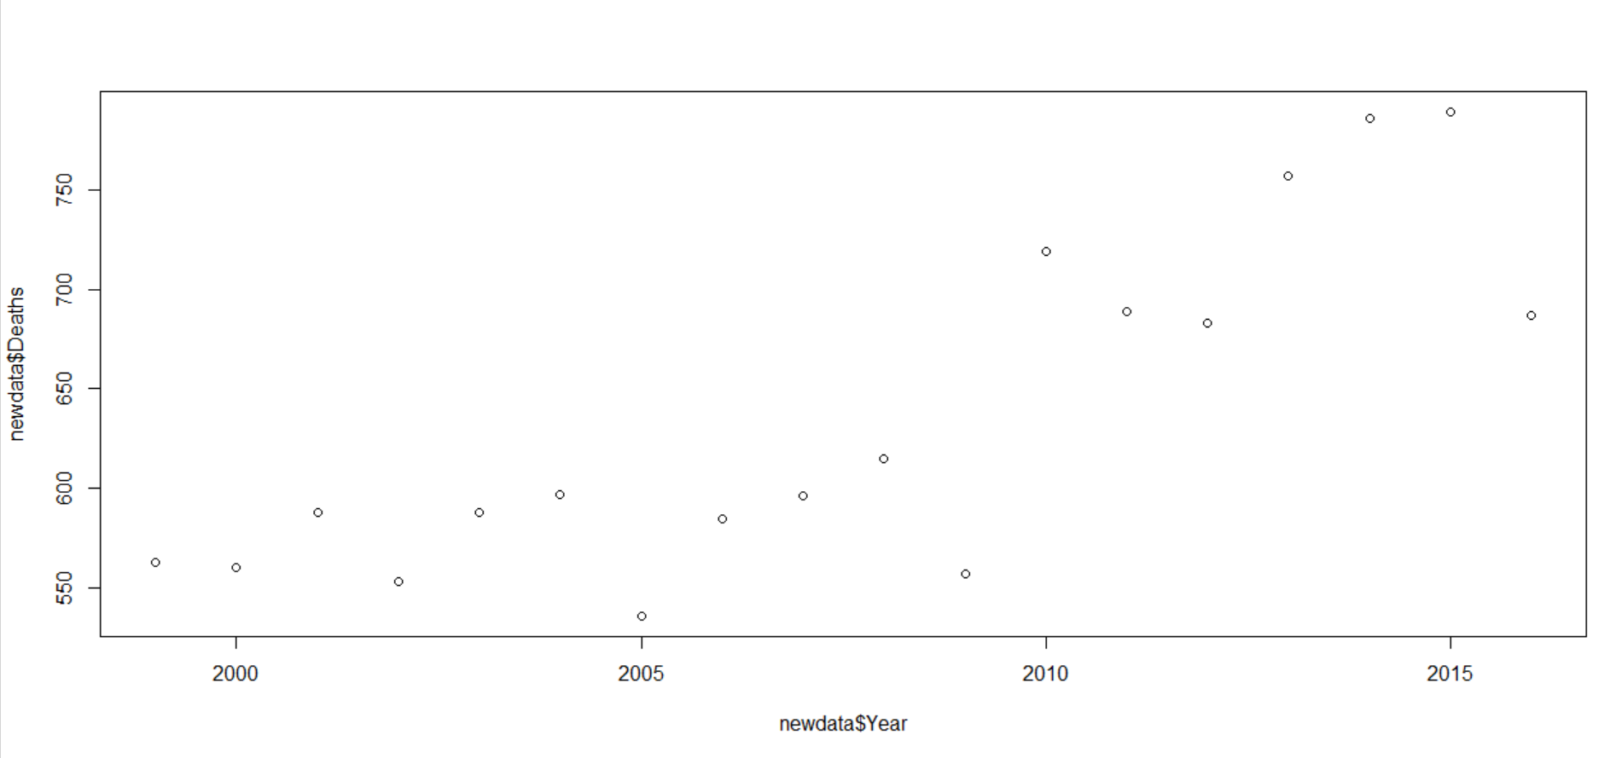
Lin/Exp Regression (NJ)
Notes:
Nj is one of the states w the lowest suicide rates, but its suicide rate of change is increasing. its suicide rate / year can be equally explained w a lin regression and a exp reg.

Slide 5
Data Table (SSEs)
Alaska | Wyoming | Montana
115.42 | 158.85 | 24.93
DC | New Jersey | New York
334.84 | 148.12 | 56
Notes:
Leading from that, states w higher suicide rates are more unpredictable in terms of linear regression. This means that places w lower suicide rates are more predictable in terms of linear regression, so policies in those states may not be so effective. All this data has had high t values and low prob of prob of linear constant being 0, so everything is significant.

Slide 6
No Leisure (Medians)
Alaska | Wyoming | Montana
21.10 | 26.50 | 22.50
DC | New Jersey | New York
21.00 | 31.60 | 37.30
Notes:
Finally, i considered the % of people having no leisure as a possible factor for higher suicide rates. My data contradicts that. Places with lower suicide rates actually had higher % of people not having enough leisure time. These are interesting observations. Later, we’ll find a factor that relates the suicide rate.

Slide 7

Scalable Analysis
Framework

Slide 8




High Throughput Multi-Omics Approach to Disease-Based Analysis

Slide 9

Case Study: Suicide

Slide 10
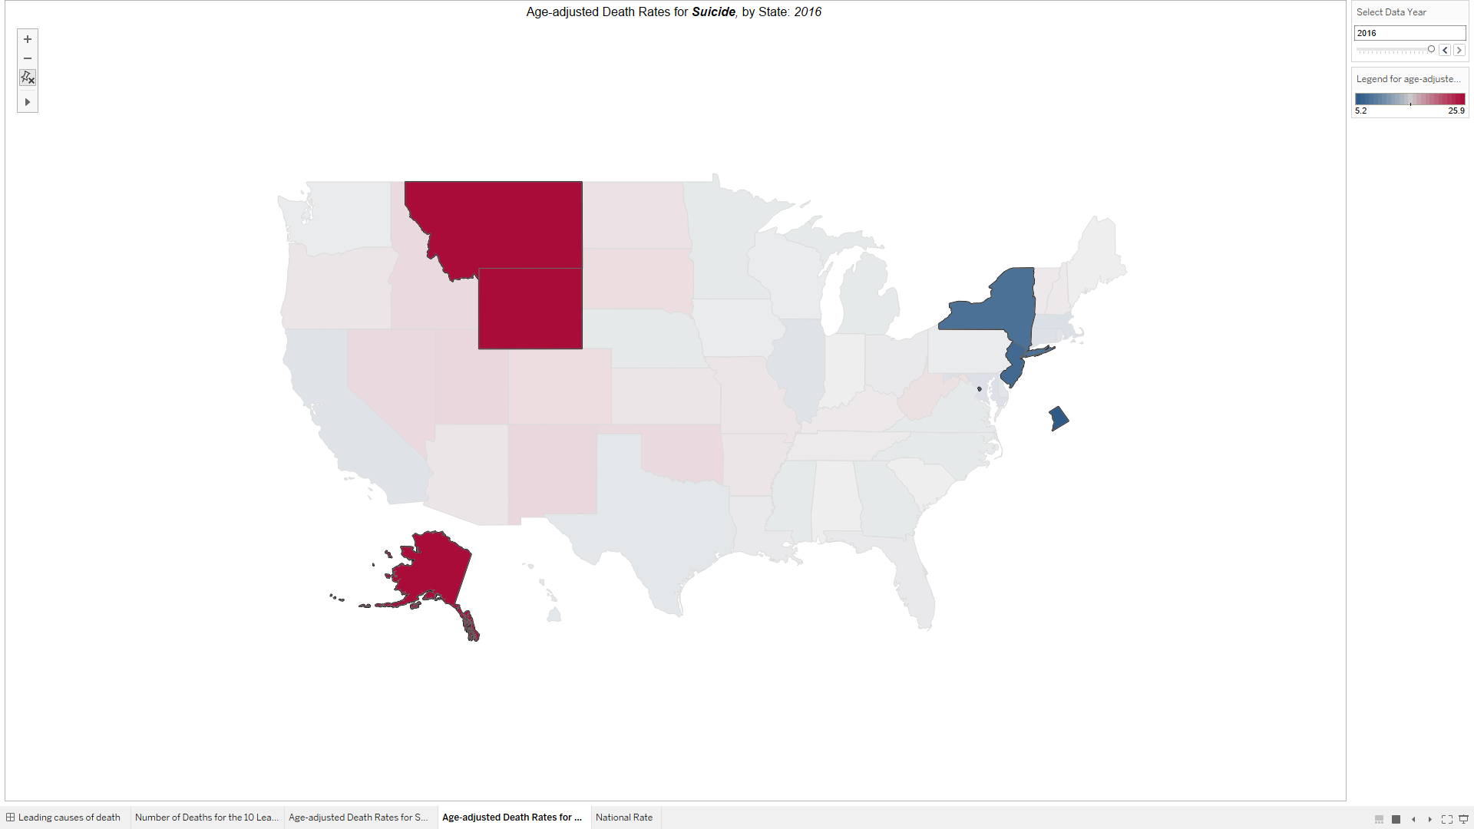
States with Highest and Lowest Suicide Rates (2016)

Slide 11
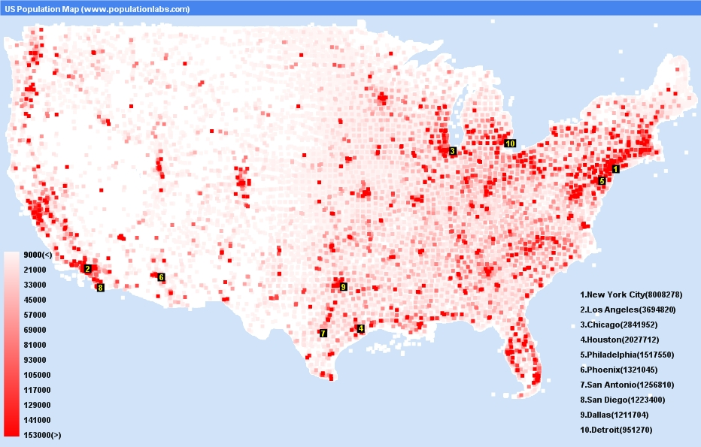
“Population Density US.” Map of USA States, phumyvungtaurental.com/population-density-map-of-usa/us-population-map-statistics-graph-most-populated-cities-density-population-density-map-of-usa-932-x-595-pixels/.
United States Population Density Map

Slide 12
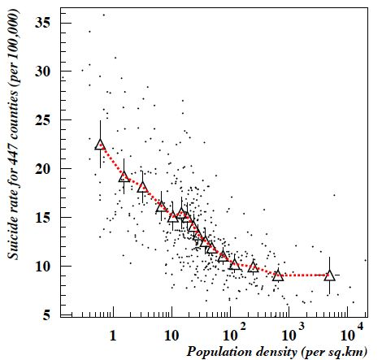
Suicide Rates on a United States normalized county-wide basis (Jeffe)

Slide 13
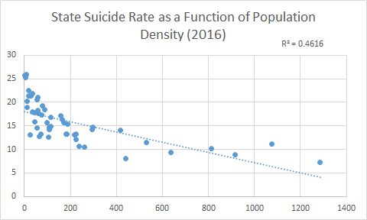
State Suicide Rate as a Function of Population Density (2016)

Slide 14
Conclusion
Strong inverse correlation between suicide rate and population density
Studies from international universities (Canada, Japan France) link loneliness to population density
Loneliness → Higher rates of suicide
Framework is adaptable for disease-based analysis

